Slide 1
Employee Performance Analysis Using Excel
PRESENTED BY: YOGESHWARAN P
REGISTER NO: 312204554
DEPARTMENT: COMMERCE
COLLEGE: K C S KASI NADAR COLLEGE OF ARTS AND SCIENCE

Slide 2
PROJECT TITLE
Employee Performance Analysis Using Excel

Slide 3
AGENDA
1.Problem Statement
2. Project Overview
3.End Users
4.Our Solution and Proposition
5. Dataset Description
6. Modelling Approach
7. Results and Discussion
8.Conclusion

Slide 4
PROBLEM STATEMENT
The pivot table presents the distribution of employee IDs across different performance categories: "Fully Meets," "Needs Improvement," and a blank category. The totals are computed as follows:
Data Inconsistency or Missing Entries:
For some employees, there is no entry under "Fully Meets" or "Needs Improvement," which may suggest missing data or incorrect categorization. Specifically:
Cristal and Sonny have entries only under "Needs Improvement," which indicates they were not evaluated under "Fully Meets," possibly due to missing or incomplete data.
Grand Total Mismatch:
The grand total row for each performance category should match the sum of the individual employee IDs in that category. However, when analyzing the data, there appears to be a discrepancy between the "Grand Total" column and the actual totals derived from the individual employee data.

Slide 5
PROJECT OVERVIEW
[Employee Performance Improvement and Pay Zone Optimization]
Data Completeness
Data Validation
Category Analysis
Blank Entries

Slide 6
WHO ARE THE END USERS?
Human Resources (HR) Department
Department Managers (Sales & Production)
Senior Leadership/Executives
Employees
Finance/Compensation Teams

Slide 7
OUR SOLUTION AND ITS VALUE PROPOSITION
Filtering - Remove missing values.
Conditional Formatting - Blanks, Background Color Shading, Data Bars, Values.
Data Filtering and Sorting - Identify specific employee groups, such as those with exceeds, needs improvements and fully meets.
Pivot table - Summary of employee performance under their current rating .
Graphs - Final Report.

Slide 8
DATASET DESCRIPTION
EMPLOYEE ID: Unique identifier for each employee in the organization.
FIRST NAME: The first name of the employee.
PERFORMANCE SCORE: A score indicating the employee's performance level (e.g., Excellent, Satisfactory, Needs Improvement).

Slide 9
MODELLING
Data set: Kaggle, Employee dataset
Feature Selection: Slicer, Conditional Formatting, Designing.
Data Cleaning: Missing values, Irrelevant data, correct errors.
Pivot Table: Employee ID, First Name, Performance score.
Chart: fully meets, Needs improvement.

Slide 10
RESULTS

Slide 11
CONCLUSION
The project focuses on improving employee performance and aligning compensation through data analysis and strategic interventions. Using Excel as a primary tool provides an accessible, cost-effective, and flexible solution for analyzing employee performance, Pay Zones, and departmental efficiency.
By identifying performance gaps, creating targeted improvement plans, and adjusting compensation strategies, the company can:
Boost overall productivity.
Increase employee satisfaction and retention.-
Ensure fair and equitable compensation across Pay Zones.
Excel's powerful data analysis, visualization, and scenario planning capabilities enable real-time tracking, informed decision-making, and clear communication of insights to stakeholders. This solution offers a comprehensive approach to enhancing workforce performance and aligning it with organizational goals.

Slide 12
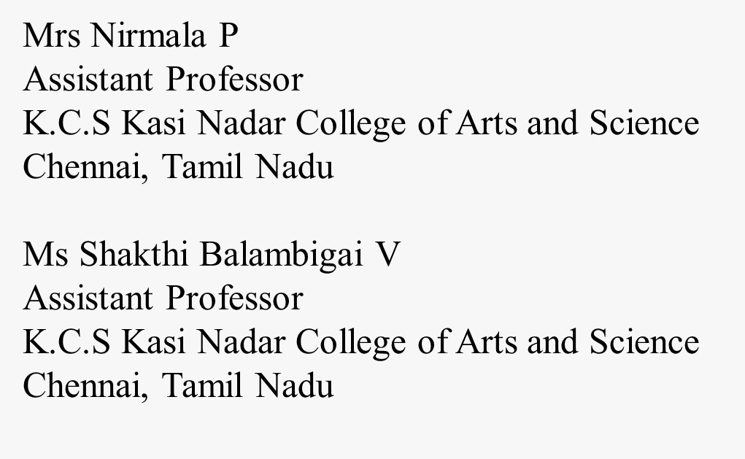
REFERENCE

